Slide 1



Recent Trends in Quantum Computing and Research Opportunties
By
Dr. Peter Nimbe
Department of Computer Science and Informatics
University of Energy and Natural Resources
Ghana

Slide 2
Outline
Introduction to Quantum computing
Current Use Cases
Future Applications
Research Opportunities

Slide 3
Introduction
Quantum computing is becoming more accessible through various deployment models - QCaaS, PaaS, AaaS, SaaS
Quantum Computing as a Service (QCaaS): QCaaS is a specialized form of IaaS that provides access to quantum computing platforms. IBM Quantum Experience for example (and almost all cloud providers) allows users to run quantum algorithms on actual quantum hardware and their simulators.🚀
Platform as a Service (PaaS): PaaS offers a platform with tools and libraries for quantum programming. Microsoft Azure Quantum is a great example providing a comprehensive development environment for quantum applications, including tools and libraries for quantum programming . 🛠️🔮
Algorithm as a Service (AaaS): AaaS delivers specific quantum algorithms as a service. D-Wave’s Leap platform, for example, offers quantum annealing algorithms that can be used for optimization problems. 🧩⚛️
Software as a Service (SaaS): SaaS provides access to quantum software applications over the internet. An example is Zapata Computing’s Orquestra, which allows users to perform complex computations and simulations. 📈
These models are making quantum computing more accessible and are paving the way for innovative solutions to complex problems.

Slide 4
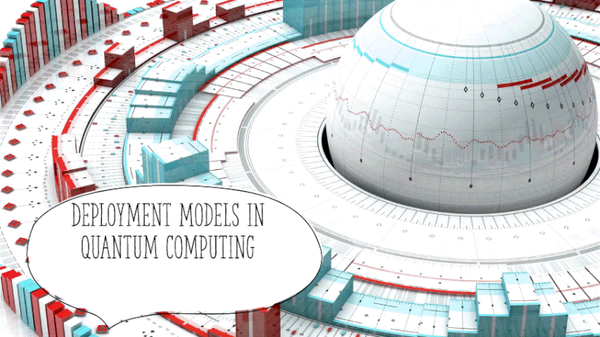

Slide 5
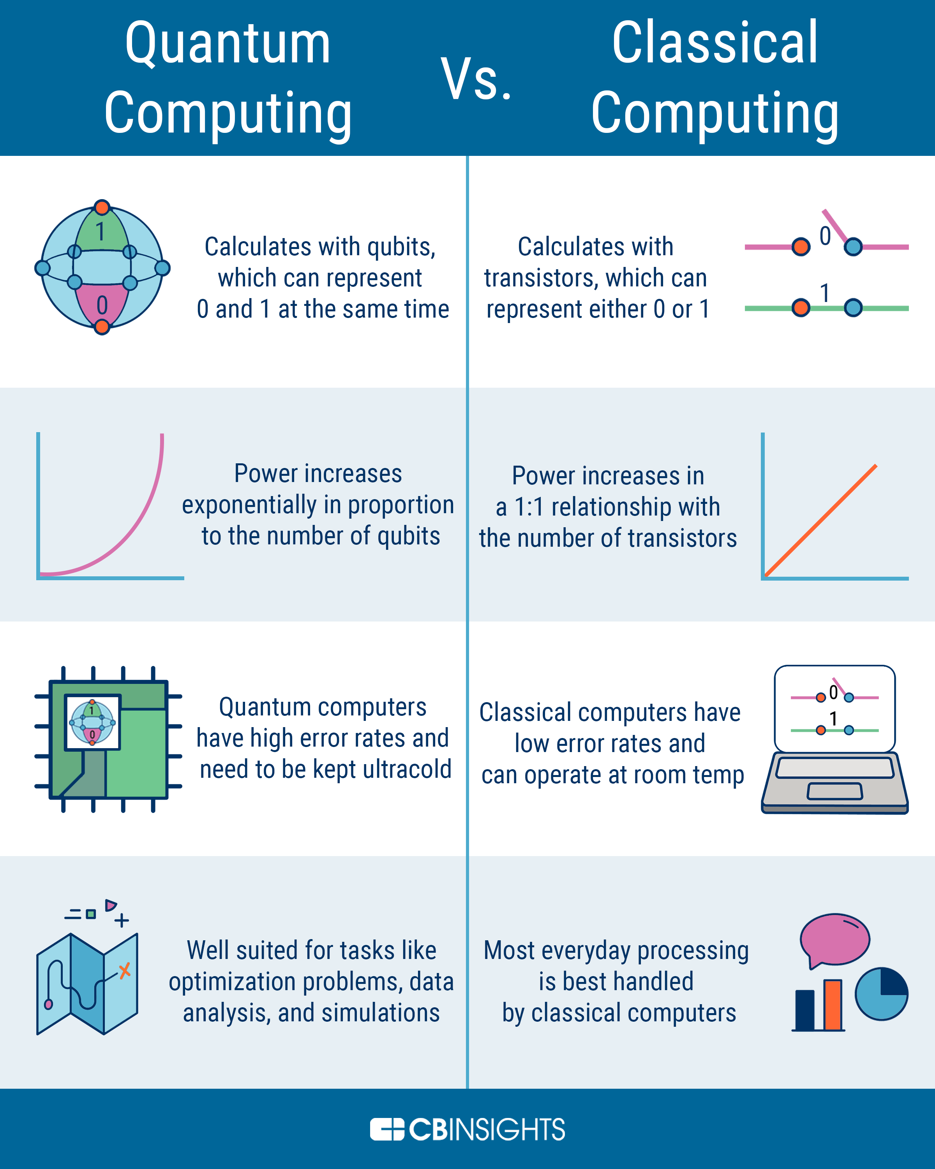
Quantum v Classical computing

Slide 6
Qiskit Outperforms other SDK’s
Qiskit outperforms other SDK's in performance testing. On the 16th of September, an article titled "Qiskit leads quantum software development kits in performance" was published by IBM.
In which, Qiskit was compared based on performance against the world's leading quantum SDKs.
Where Qiskit outperformed them by using "Benchpress" a new open-source package for Quantum Benchmarking.

Slide 7
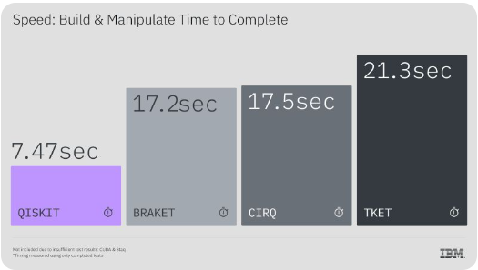
Qiskit Outperforms other SDK’s
Qiskit’s Performance: - Outperformed all other SDKs (e.g., TKET, Cirq, Braket) in circuit building, manipulation, and transpilation. - Transpilation was 13x faster and used 24% fewer two-qubit gates than TKET. - Passed more tests than any other SDK, indicating broad capability.

Slide 8
Current Usecases
Quantum computing (QC) has often felt like a theoretical concept due to the many hurdles researchers must clear.
Chief among them is upping the number of qubits, or the units of information that these impressive pieces of hardware use to perform tasks.
Whereas classical computer “bits” exist as 1s or 0s, qubits can be either — or both simultaneously.
That’s key to massively greater processing speeds, which are necessary to simulate molecular-level quantum mechanics.

Slide 9
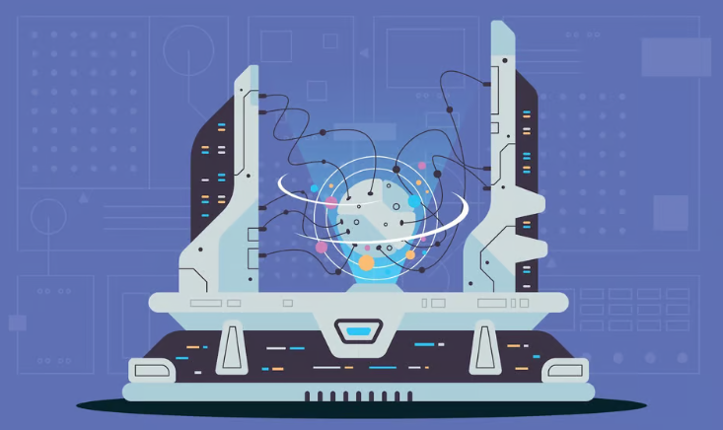
10 Quantum Computing Applications to Know
Artificial intelligence
Better batteries
Cleaner fertilization
Cybersecurity
Drug development
Electronic materials discovery
Financial modeling
Solar capture
Traffic optimization
Weather forecasting and climate change

Slide 10
Future of Quantum Computing
2023 began with many business leaders being blindsided by the mainstream adoption of generative AI.
Critics have often dismissed quantum computing as overhyped.
But as it prepares to enter center stage, all eyes will be on whether it can deliver on its promises of a seismic shift in computational capabilities.

Slide 11
Key Takeaways
After AI, quantum computing may be the next shift we see worldwide, as engineers focus on qubit quality and error correction.
Data security is a pressing concern as quantum computing threatens existing encryption standards.
Sectors such as finance, pharmaceuticals, sustainability, and regulated industries are exploring the potential impact of quantum computing in their respective fields.

Slide 12
Key Takeaways
The transformative potential of quantum computing comes with ethical and security challenges, requiring a balanced and informed approach by businesses and especially government leaders.
This year 2024, it was expected that quantum computing field would transition from physical qubits to error-corrected logical qubits and see increased global collaboration in quantum research, marking a big year for the technology.

Slide 13
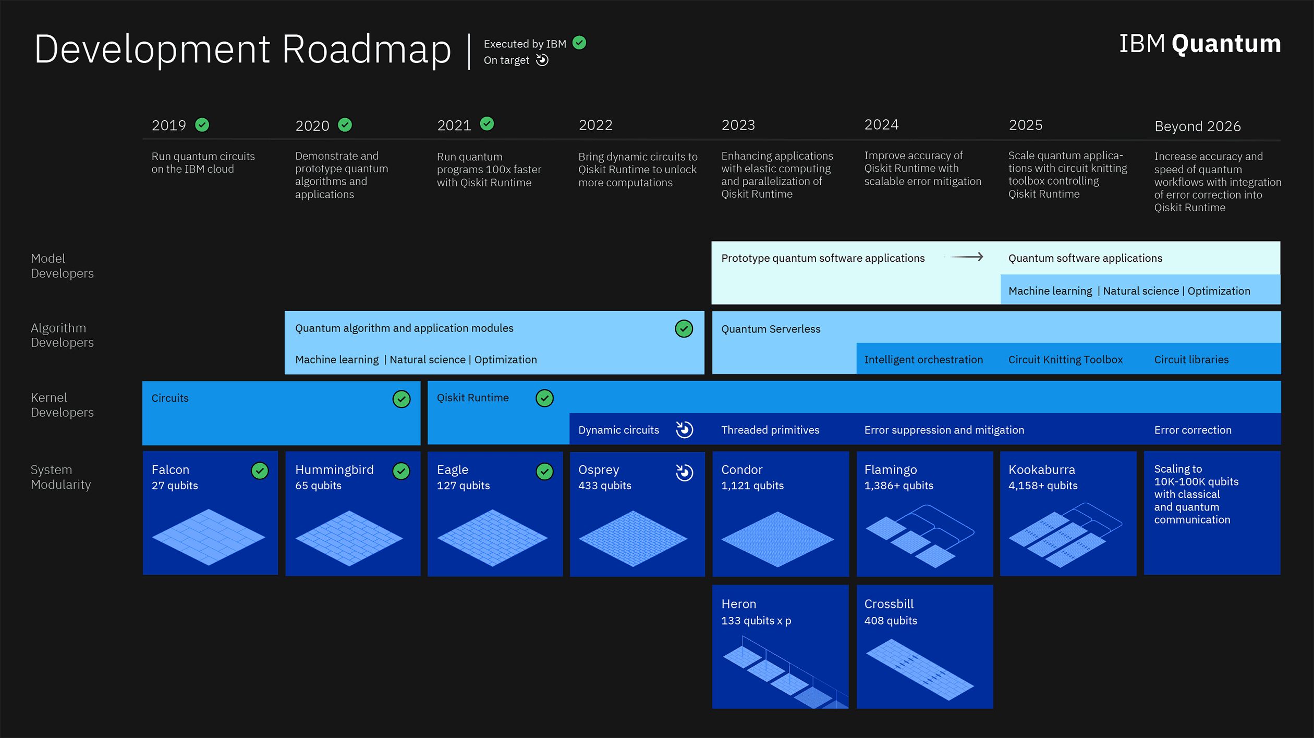

Slide 14
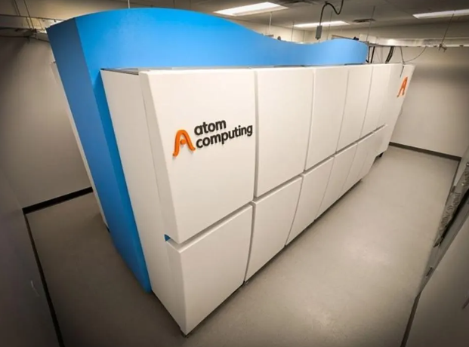
Atom Computing
Atom Computing’s recent announcement of a 1,225-qubit quantum computer, nearly tripling IBM’s Osprey, which was the previous front-runner, underscores that we’re on the cusp of a new era in computing.
Atom Computing’s newly announced second-generation neutral atom quantum computer.

Slide 15
Atom Computing
This leap amplifies quantum computing’s potential to revolutionize sectors like pharmaceuticals and cybersecurity, enabling calculations of unimaginable complexity.
However, there is an increasing belief that quantum computing will be determined by the quality of qubits over sheer quantity.

Slide 16
Quality Qubits Over Quantity
A shift in the quantum computer market in 2024, departing from the obsession over the concepts of quantum advantage and raw qubit count.
Instead, the industry is set to pivot towards addressing the more critical issue of error correction and practical problem-solving applications.
error correction and functional applications signifies a maturation of the field

Slide 17
Hackers Will Store Data to Decrypt Later
Timely warning about the speed to which Quantum technology is advancing and the need for quantum-resistant encryption methods is no longer optional.
The looming threat of a quantum computer breaking current encryption standards, such as RSA or ECC encryption algorithms, underscores the need for organizations of all sizes across industries to evaluate where they may be at risk and migrate to post-quantum cryptography today.

Slide 18
NIST Recent Announcement
NIST has released a final set of encryption tools designed to withstand the attack of a quantum computer.
These post-quantum encryption standards secure a wide range of electronic information, from confidential email messages to e-commerce transactions that propel the modern economy.
NIST is encouraging computer system administrators to begin transitioning to the new standards as soon as possible.

Slide 19

NIST calls for Adoption of the new standards

Slide 20
More Details on the New Standards
Encryption uses math to protect sensitive electronic information, including secure websites and emails.
Widely used public-key encryption systems, which rely on math problems that computers find intractable, ensure that these websites and messages are inaccessible to unwelcome third parties.
Before making the selections, NIST considered not only the security of the algorithms’ underlying math, but also the best applications for them.

Slide 21
More Details on the New Standards
The new standards are designed for two essential tasks for which encryption is typically used: general encryption, used to protect information exchanged across a public network; and digital signatures, used for identity authentication.
NIST announced its selection of four algorithms — CRYSTALS-Kyber, CRYSTALS-Dilithium, Sphincs+ and FALCON — slated for standardization in 2022 and released draft versions of three of these standards in 2023.
The fourth draft standard based on FALCON is planned for late 2024.

Slide 22
Misconceptions Around Quantum Computing
Quantum computers are not 10 years away or 15 years away.
“We have quantum computers right now, which can do things that classical computers can’t. Another misconception is that quantum computers will only be good for one thing.”
While the primary focus of quantum computing development has been on business applications, the technology has inadvertently become a game-changer for complex scientific challenges.
For example, condensed matter physics and high-energy physics problems, often the purview of organizations like CERN and projects like the Large Hadron Collider, can now be approached in ways previously thought impossible.

Slide 23
What Sectors Will Quantum Computing Impact?
Financial services, giant banks, and trading firms leverage quantum capabilities for portfolio optimization and enhanced fraud detection.
The pharmaceutical sector is eyeing quantum computing for efficient drug discovery.
At the same time, companies focused on sustainability are exploring new material sciences, exemplified by work with BMW and Airbus on hydrogen fuel cells.

Slide 24
What Sectors Will Quantum Computing Impact?
“Quantum computing also promises to revolutionize regulated industries from healthcare to aviation by providing much-needed transparency and traceability in AI algorithms, mitigating the “black box” problem in AI decision-making.”
However, the risks are as formidable as the rewards. A significant concern is data encryption, as algorithms like Shor’s Algorithm have shown that quantum computing could potentially crack existing encryption methods.
This introduces not only technical challenges but also ethical considerations in how the technology should be harnessed for the greater good while ensuring security.

Slide 25
What is the Future of Quantum Computing?
Quantum computing is not a futuristic concept; it’s a current reality with pivotal milestones on the near horizon.
One immediate milestone is reaching a level where quantum machines routinely outperform even the world’s most advanced supercomputers in simulation tasks, ushering us into an era where classical computing becomes inept at emulating quantum capabilities.
Business and government leaders need to focus on the burgeoning applications of quantum technology in areas from cybersecurity to high-energy physics.

Slide 26
What is the Future of Quantum Computing?
“We will start to see it inserted into places that influence our daily lives. We may not ever touch a quantum computer ourselves, but it might be an application you’re working on your mobile phone that is going back across the world and reaching in and doing something from a quantum computer.”
Much like the early stages of the internet and classical computing, quantum computing will start with niche applications but is poised to become ubiquitous, subtly powering tasks on our everyday devices like mobile phones.

Slide 27
Challenges in a Quantum Computing Future
On the one hand, quantum computing opens vistas for groundbreaking research in fields like medicine, material science, and cryptography, acting as a catalyst for innovation and pushing the boundaries of what we deem computationally possible.
On the other hand, the disruptive potential of this technology raises critical questions about data security, ethical implementation, and the creation of a digital divide.

Slide 28
Challenges in a Quantum Computing Future
“As quantum capabilities burgeon, we are faced with the compelling need to invest in error-correction mechanisms and focus on the quality of qubits rather than mere numerical superiority.”
Ignoring these intricacies could lead to a precarious future where the power of quantum computing is either underutilized or misused.
Therefore, the journey ahead demands a calculated, ethical, and multi-disciplinary approach, converging technological prowess with regulatory foresight.

Slide 29
Challenges in a Quantum Computing Future
“Quantum computing could shatter current encryption models, demanding a total overhaul of cybersecurity protocols.”
Furthermore, the technology is still in its infancy, grappling with issues like qubit stability and error correction while presenting a high barrier to entry in terms of cost.
As we enter 2024, business leaders must balance the transformative potential against the existential risks and operational challenges of quantum computing.
As we pivot from the era of classical computing to a quantum future, business leaders and policymakers must proceed with a balanced and informed strategy, weighing the monumental benefits against the existential challenges that quantum computing inevitably brings.

Slide 30
The Quantum Leap of 2024: From Physical Qubits to Global Collaborations
Yuval Boger, CMO at QuEra Computing, predicts that in 2024, the quantum computing field will undergo monumental shifts.
“One of the most significant is the transition from the era of physical qubits to that of error-corrected logical qubits, marking a leap towards more stable and reliable quantum computations.”
Boger also believes this will coincide with the increased integration of quantum processors into high-performance computing (HPC) centers, creating a hybrid computational landscape that leverages the unique capabilities of both classical and quantum machines.

Slide 31
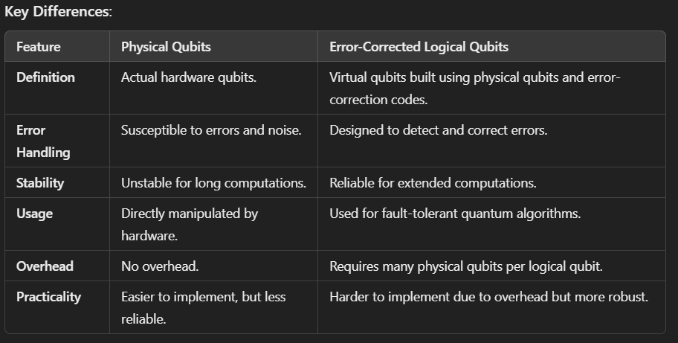

Slide 32
The Quantum Leap of 2024: From Physical Qubits to Global Collaborations
“Concurrently, we will see European nations opening up their national quantum programs to U.S. vendors. This collaborative stance is driven by the realization that staying at the forefront of quantum advancements often necessitates a more global approach.”
This is exemplified by the notion that ‘the best French quantum technology’ is not necessarily synonymous with ‘the best quantum technology for France’.
The same logic could easily be applied to other countries, such as Germany, UK, Finland, etc. For these reasons alone, 2024 should be extremely exciting for the future of quantum computing.

Slide 33
The Bottom Line
quantum computing could quickly usher in a game-changer moment that will affect us all.
Imagine faster drug discoveries or unhackable passwords; that’s the good side.
But there’s also a flip side: current online security could be easily cracked, and the technology is still rough around the edges, often expensive and hard to use.
As we move from the old world of computing into this exciting yet unpredictable quantum era, leaders in business and government must be both cautious and clever.
They must embrace the giant leaps forward and prepare for the potential pitfalls. In simple terms, quantum computing offers a world of extraordinary possibilities, but it’s a tool we must learn to wield wisely.

Slide 34

2025 – International Year of Quantum Computing
The United Nations Proclaims 2025 as the International Year of Quantum Science and Technology.
The declaration recognizes the potential of quantum science to drive innovations in sustainable development and global communications
The year will help improve the appreciation by the general public of the importance of quantum science and technology in research and development in scientific areas relevant to achieving the SDGs
As well as awareness among decision-makers and leaders worldwide of the need to support educational and research activities in quantum science and technology on national levels.

Slide 35
2025 – International Year of Quantum Computing
Quantum science and technology has enormous potential to impact on critical societal challenges such as climate, energy, food production, healthcare, and clean water.
Therefore, the idea of proclaiming 2025 as the International Year of Quantum Science and Technology was proposed by major scientific bodies and academies.

Slide 36
2025 – International Year of Quantum Computing
Support for the initiative comes from a wide representative group of over 30 major national scientific societies and academies from Africa, Asia, Europe, the Middle East, the American Continent and Oceania (https://quantum2025.org/).
It has received the strong endorsement of the International Union of Pure and Applied Physics (IUPAP) at its 30th General Assembly on 21 October 2021 and from a number of important regional bodies, including the World Academy of Science (TWAS), the African Academy of Sciences (AAS) and the African Physical Society (AfPS); etc
A great support was also received from Member States, where Mexico, Brazil, the Arab Republic of Egypt, Ghana, Japan, the Hashemite Kingdom of Jordan, the State of Kuwait, the Republic of Korea, the Republic of Paraguay, the Republic of Serbia, the Kingdom of Spain, Senegal, and the Republic of South Africa, took the lead role in bringing this request forward

Slide 37

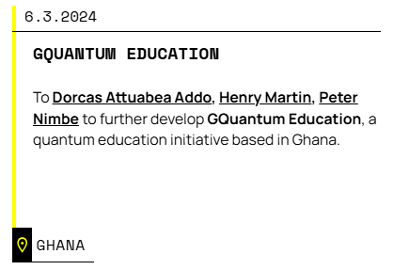
Research and Education Funding Opportunities
- https://unitary.fund/
A non-profit helping create a quantum technology ecosystem that benefits the most people.
Runs a microgrant program to fund explorers across the world to work on quantum technologies. Do you have an idea for a project?
They also have open positions for Members of the Technical Staff.

Slide 38

Open Quantum Institute
- The Open Quantum Institute (gesda.global)
An initiative hosted by CERN, born at GESDA, supported by UBS
OQI draws on GESDA’s ability to connect scientists and technologists, the diplomatic community, the private sector, philanthropic actors and global citizens, inorder to pioneer future science and technology for good.
Has 4 objectives;
Accelerating applications for humanity
Access for all
Advancing capacity building and
Activating multilateral governance for the SDGs

Slide 39
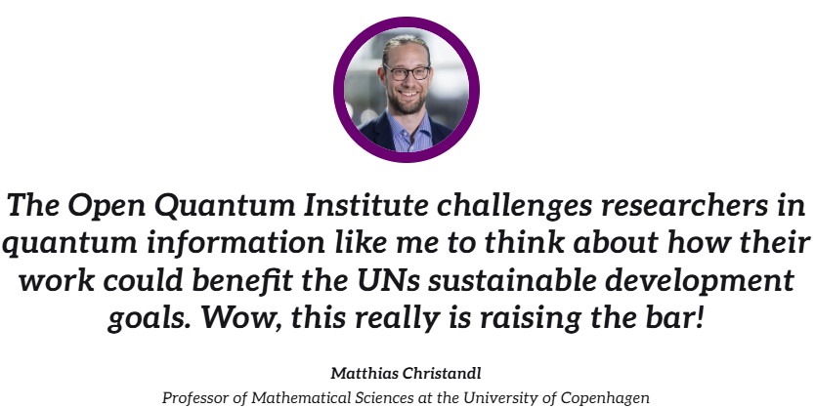
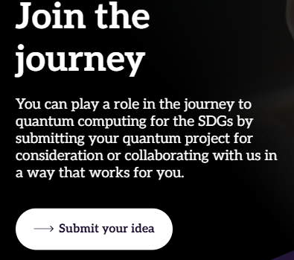
Applications – The Open Quantum Institute (gesda.global)

Slide 40

Funding Opportunities for Engineering Research in Quantum Information Science and Engineering | NSF - National Science Foundation
Encourages research and education proposals related to quantum information science and engineering as an emerging industry.
The Directorate for Engineering encourages the submission of all types of research and education proposals related to QISE, including proposals in the following areas:
Quantum devices
Quantum systems,
Quantum information processing
Quantum-based network security

Slide 41
Funding Opportunities for Engineering Research in QISE
Cryogenics
Quantum manufacturing
Turbulent flows, heat transfer, and material behavior,
Thermal management for quantum technologies
Quantum technology interfaces
Process design, optimization, and control.
The Engineering Directorate encourages the submission of QISE-related proposals to the ENG core and cross-NSF programs listed below, and to other relevant programs
https://new.nsf.gov/funding/opportunities/funding-opportunities-engineering-research-quantum

Slide 42

Scholarships and awards at
Opportunities for new and current graduate students
Students enrolled in the Quantum Information graduate program will be eligible for Institute for Quantum Computing (IQC) scholarships.
https://uwaterloo.ca/institute-for-quantum-computing/programs/graduate-studies/scholarships-and-awards

Slide 43

Applied Quantum Computing Challenge program
Collaborates with industry and academia to support commercial innovation to build on Canada's position as a global leader in applied quantum computing.
Supports quantum initiatives across the Government of Canada, working with federal departments, agencies and Crown corporations to explore applications of quantum computing for public service operations and program delivery.

Slide 44

Applied Quantum Computing Challenge program
Developed in alignment with the development of the Government of Canada's National Quantum Strategy.
The strategy will amplify Canada's significant strength in quantum research; grow our quantum‑ready technologies, companies and talent; and solidify Canada's global leadership in this area.

Slide 45

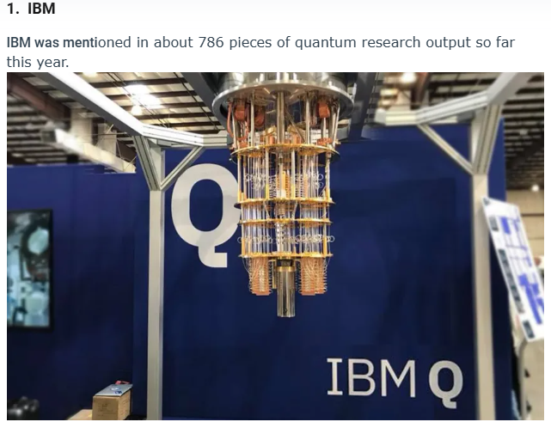
Top 18 Institutions Leading Quantum Computing Research in 2024
IBM research teams and equipment were involved in the output including the papers: Quantum Computer Systems for Scientific Discovery, Evidence of the entanglement constraint on wave-particle duality using the IBM Q quantum computer (Physical Review A) and Application of Quantum Machine Learning to High Energy Physics Analysis at LHC using IBM Quantum Computer Simulators and IBM Quantum Computer Hardware, presented at 2021 Proceedings of 40th International Conference on High Energy physics.

Slide 46
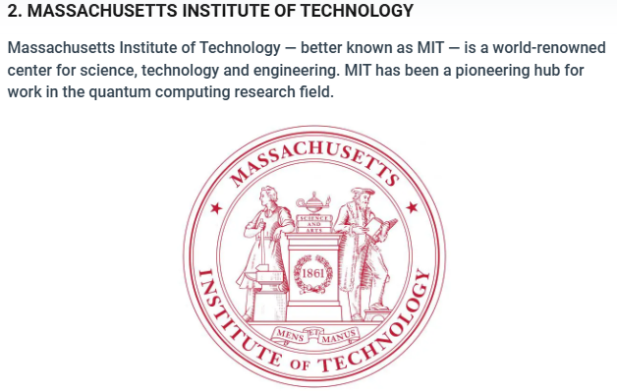
In 2024, scientists from MIT played roles in major research on quantum computing technology that was published in leading scientific journals, including: Room-temperature photonic logical qubits via second-order nonlinearities, which appeared in Nature Communications; Capturing Non-Markovian Dynamics on Near-Term Quantum Computers, Physical Review Research; and Creating Majorana modes from segmented Fermi surface, again in Nature Communications.

Slide 47
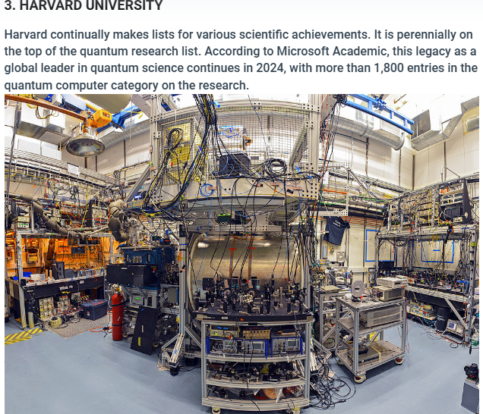
Some of the quantum computing studies published both in major scientific journals and pre-print servers, such as ArXiv, that include Harvard researchers are: Quantum Computing lab at the Frontiers of Biological Sciences in Nature Methods; Quantum Information and Algorithms for Correlated Quantum Matter in Chemical Reviews and Quantum Computing and Quantum Information Storage in Physical Chemistry Chemical Physics.

Slide 48
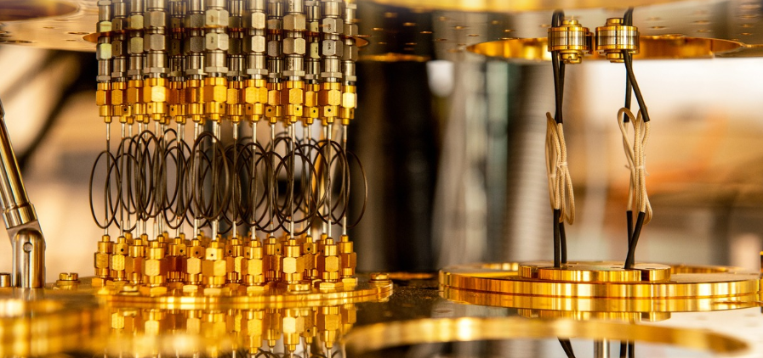
4. Max Planck Society
5. University of Chicago
6. Chinese Academy of Sciences
7. University of California, Berkeley
8. University of Maryland, College Park
9.Princeton University
10. Google Quantum Computer Research Center
11. University of Tokyo
12. University of Science and Technology of China
13. University of Washington
14. University of Oxford
15. Duke University
16. National Institute of standards and technology
17. Stanford University
18. California Institute of Technology

Slide 49
References
https://www.techopedia.com/future-of-quantum-computing
https://www.forbes.com/sites/moorinsights/2023/10/24/atom-computing-announces-record-breaking-1225-qubit-quantum-computer/?sh=329c93b6491a
https://www.nist.gov/news-events/news/2024/08/nist-releases-first-3-finalized-post-quantum-encryption-standards
https://www.hpcwire.com/2024/08/13/nist-issues-post-quantum-cryptography-standards-and-calls-for-their-adoption/
https://unitary.fund/
https://oqi.gesda.global/
https://new.nsf.gov/funding/opportunities/funding-opportunities-engineering-research-quantum
https://uwaterloo.ca/institute-for-quantum-computing/programs/graduate-studies/scholarships-and-awards
https://nrc.canada.ca/en/research-development/research-collaboration/programs/applied-quantum-computing-challenge-program
https://thequantuminsider.com/2022/05/16/quantum-research/

